Slide 1


Harinder K Cheema
Nov 09, 2021

Slide 2

Outline
Executive Summary
Introduction
Methodology
Results
Conclusion
Appendix

Slide 3
Executive Summary
Summary of methodologies
Data collection
Data wrangling
EDA with data visualization
EDA with SQL
Building an interactive map with Folium
Building a Dashboard with Plotly Dash
Predictive analysis (Classification)

Slide 4
Executive Summary
Summary of all results
Exploratory data analysis results
Interactive analytics demo in screenshots
Predictive analysis results

Slide 5
Introduction
Project background and context
Many companies are providing commercial and affordable space travel for everyone. The most successful of them all is without a doubt SpaceX. SpaceX has ventured into many spaces like Sending spacecraft into the International Space Station, providing satellite internet access through Starlink, a satellite internet constellation, and sending manned missions into the space.
In this project we will assess the cost of a launch by determining if the first stage of the rocket launch will be successful or not by using various methodologies of Data Science.
Problems you want to find answers
Determine if the first stage of the rocket launch will be successful or not? We need to determine what variables impact a successful rocket launch.

Slide 6


Slide 7
Methodology
Executive Summary
Data collection methodology:
Using REST API endpoints
Using Web Scrapping
Perform data wrangling
Data wrangling is the process of cleaning and organizing data for analysis. The process typically includes converting and mapping data from one raw form into another format for convenient analysis and decision making.
Perform exploratory data analysis (EDA) using visualization and SQL
EDA is the process of performing initial investigations on data, it is a good practice to understand data first-hand. It helps to discover patterns, discover anomalies and check assumptions. There is no structured way to do EDA, but it is an iterative process.

Slide 8
Methodology
Executive Summary
Performed interactive visual analytics using Folium and Plotly Dash
Perform predictive analysis using classification models
Predictive data analysis uses current and past data to let you make predictions about the future or other unknowns. You could predict the likelihood of an event or a specific situation using the given data that is being analyzed.
The process involves preprocessing to standardize the data, and then performing a train-test split, allowing us to split our data into a training set and a test set. The most common split ratio is 80:20 i.e. 80% of the dataset goes into training set and 20% of the dataset goes into the testing set.
Train/Test split works well with large datasets. Scikit-learn or Sklearn is a Python library that offers a train_test_split function for splitting data set. By default, Sklearn train_test_split makes random partitions. The library offers various features for data processing that can be used for classification, clustering and model selection.

Slide 9
Data Collection
Describe how data sets were collected.
REST API calls to SpaceX endpoints. The API will give is data about launches, including information about the rocket used, payload delivered, launch specifications, landing specifications, and landing outcome.
Web Scrapping is another popular data source for obtaining the Falcon 9 Launch data using BeautifulSoup.
SpaceX API Web Scrapping
Get HTML data from Web
Use SpaceX REST API
API returns data using JSON
Normalize data into file data such as .csv
Extract data using BeautifulSoup
Normalize data into .CSV files

Slide 10
Data Collection
You need to present your data collection process use key phrases and flowcharts
Find and download the SpaceX dataset either using web scrapping or using the REST API endpoints.
The dataset should contain tabular data (rows and columns), preferably in CSV/JSON/XLS or other formats that could be read using Pandas. If it is not in a compatible format, you may have to write code to convert it into a desired format.

Slide 11

Data Collection
You need to present your data collection process use key phrases and flowcharts
Exploratory Data Analysis
Raw Data Collected
Data Processed
Data Cleaned
Data Product
Communicate Visualize Report
Models and Algorithms
End User

Slide 12
Data Collection – SpaceX API
SpaceX REST calls for data collection
spacex_url="https://api.spacexdata.com/v4/launches/past"
response = requests.get(spacex_url)
GitHub URL for Data Collection of past SpaceX launches:
capstone-project/jupyter-labs-spacex-data-collection-api-Final.ipynb at main · cheemh/capstone-project (github.com)
Rest API Endpoints to extract data
api.spacexdata.com/v4/
api.spacexdata.com/v4/cores
api.spacexdata.com/v4/capsules
api.spacexdata.com/v4/past/launches

Slide 13
Data Collection - Scraping
Present your web scraping process using key phrases and flowcharts
Add the GitHub URL of the completed web scraping notebook, as an external reference and peer-review purpose
Information extracted using Web Scrapping Tools
Web
Scrapped data stored in database
Data filtered
Data Displayed to users

Slide 14
Data Wrangling
Describe how data were processed
Load the dataset into a data frame using Pandas
Explore the number of rows & columns, ranges of values etc.
Handle missing, incorrect and invalid data. Clean the data from erroneous elements.
Perform any additional steps (parsing dates, creating additional columns, merging multiple dataset etc.)
Compute the mean, sum, range and other interesting statistics for numeric columns. Consolidate the data from various sources or data sets into a coherent whole.
Filtering data through determined settings for the processing.

Slide 15
Data Wrangling
You need to present your data wrangling process using key phrases and flowcharts
Data Discovery – Understanding and getting familiar with your data. Examine your data to find patterns and trends in the data.
Data Structuring – When the raw data is collected, it has no definite structure, which means that it lacks an existing model and is completely disorganized. It needs to be restructured to fit in with the Analytical Model deployed by your business and giving it a structure allows for better analysis.
Data Cleaning – Most people use the words the Data Wrangling and Data Cleaning interchangeable. However, these are two very different processes. Although a complex process, cleaning is just a single aspect of the overall Data Wrangling process. Cleaning removes outliers from your dataset that can potentially skew your results when analyzing the data. It changes any null values and standardizes the data format to improve quality and consistency. It identifies duplicate values and makes it easy to handle.

Slide 16
Data Wrangling
Data Enriching – The data is enriched and improved in accuracy for your analysis by combining your raw data with additional data from other sources such as internal systems.
Data Validation – Validating the data is an activity that services any issues in the quality of your data so they can de addressed with the appropriate transformations.
Data Publication – By this time, all the steps are completed, and the data is ready for analytics.
https://github.com/adgsenpai/IBM-DataScience-SpaceX-Capstone/blob/main/Data%20Wrangling.ipynb

Slide 17
EDA with Data Visualization
In the dataset, there are several cases where the booster did not land successfully. We can convert these outcomes into Training Labels with 1 means the booster successfully landed and 0 means it was unsuccessful.
Perform Exploratory Data Analysis EDA on dataset
Calculate the number of launches at each site
Calculate the number of launches at each site
Calculate the number and occurrence of mission outcome per orbit type
Export dataset as .CSV
Create a landing outcome label from Outcome column
Identify the success rate for every landing in the dataset

Slide 18
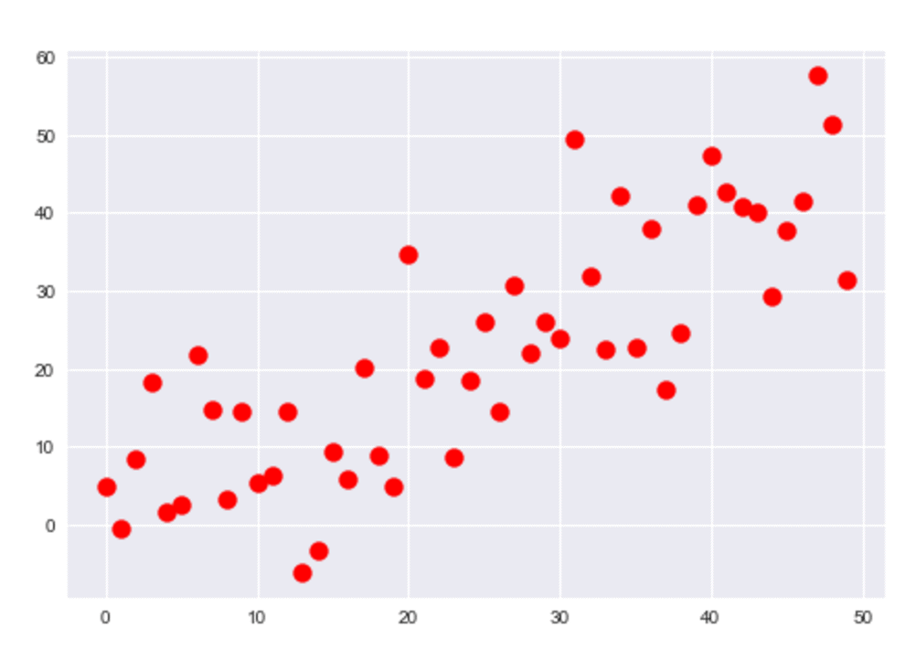
EDA with Data Visualization
Scatter Graphs – Scatter plots shows how much one variable is affected by another. The relationship between the two variables is called their correlation. Scatter plots usually used on a large data set.
Flight Number vs. Launch Site
Payload vs. Payload Mass
Payload vs. Launch Site
Orbit vs. Flight Number
Payload vs. Orbit Type
Orbit vs. Payload Mass
This Photo by Unknown Author is licensed under CC BY-NC

Slide 19
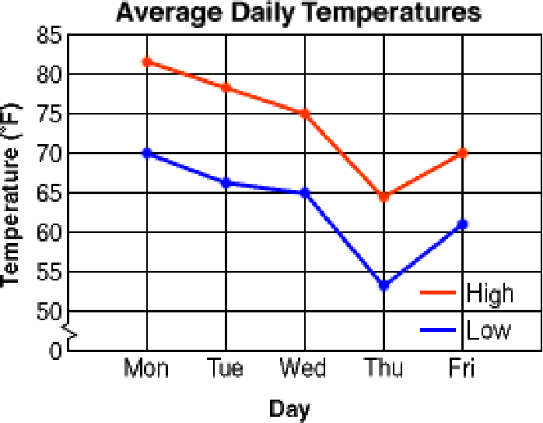
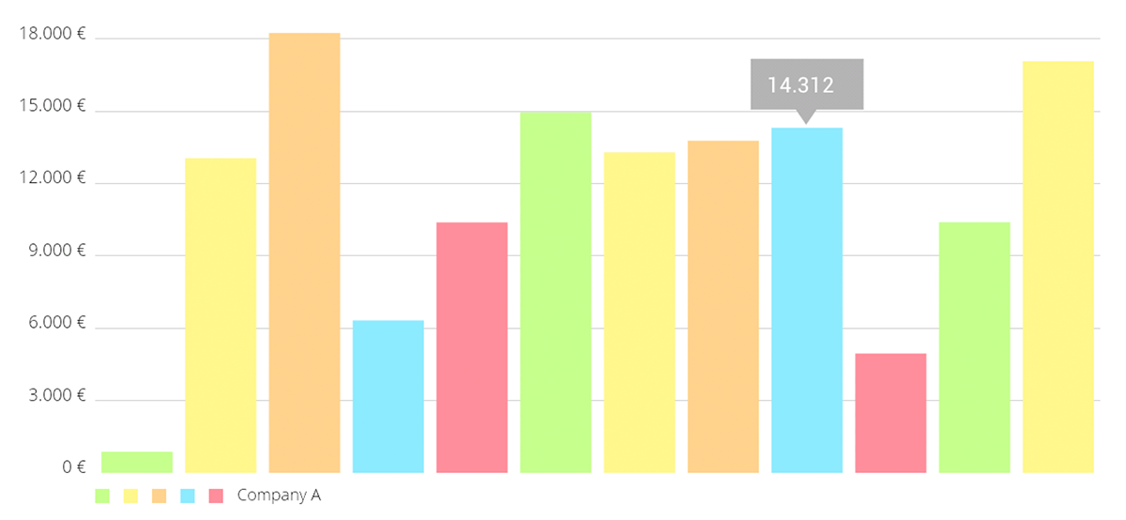
EDA with Data Visualization
Line Graphs – Line graphs also known as line plot or a line chart is a graph that uses lines to connect the individual data points. It is usually a type of chart that is used to show the information that changes over time.
Success Rate vs Year
Bar Graph – A bar diagram makes it easy to compare sets of data between different groups at a glance. The graph represents the categories on one axis and a discrete value in the other. Bar charts can also show changes in data over a period of time.
Mean vs Orbit

Slide 20
EDA with SQL
SQL queries that were performed to fetch information about the dataset
Display the names of the unique launch sites in the space mission
Display 5 records where launch sites begin with the string 'CCA'
Display average payload mass carried by booster version F9 v1.1
List the date when the first succesful landing outcome in ground pad was acheived.
List the names of the boosters which have success in drone ship and have payload mass greater than 4000 but less than 6000
List the total number of successful and failure mission outcomes
List the names of the booster_versions which have carried the maximum payload mass. Use a subquery
List the failed landing_outcomes in drone ship, their booster versions, and launch site names for the in year 2015
GitHub URL of your completed EDA with SQL notebook:
https://github.com/cheemh/capstone-project/blob/main/jupyter-labs-eda-sql-coursera.ipynb

Slide 21
EDA with SQL
Rank the count of landing outcomes (such as Failure (drone ship) or Success (ground pad)) between the date 2010-06-04 and 2017-03-20, in descending order
Github URL of the completed SQL notebook
https://github.com/cheemh/capstone-project/blob/main/jupyter-labs-eda-sql-coursera.ipynb

Slide 22

Build an Interactive Map with Folium
We assigned the dataframe launch_outcomes to classes 0 and 1 with Green and Red markers on the map in a MarkerCluster()
Explain why you added those objects
Add the GitHub URL of your completed interactive map with Folium map, as an external reference and peer-review purpose

Slide 23
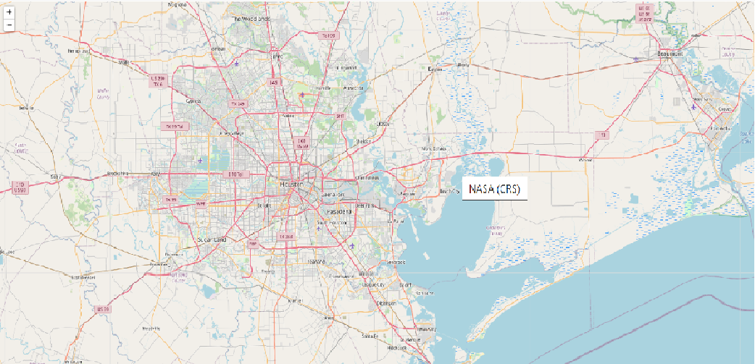
Create and add folium.Circle and folium.Marker for each launch site on the site map
Build a Dashboard with Plotly Dash
To visualize the Launch Data into an interactive map. We took the Latitude and Logitude coordinates at each launch site and added a Circle Marker around each launch site with a label of the name of the launch site.
Summarize what plots/graphs and interactions you have added to a dashboard
Explain why you added those plots and interactions
Add the GitHub URL of your completed Plotly Dash lab, as an external reference and peer-review purpose

Slide 24
Predictive Analysis (Classification)
Github URL of the Predictive Analysis Classification
https://github.com/cheemh/capstone-project/blob/main/jupyter-labs-eda-dataviz.ipynb

Slide 25
Results
Exploratory data analysis results
Interactive analytics demo in screenshots
Predictive analysis results

Slide 26


Slide 27
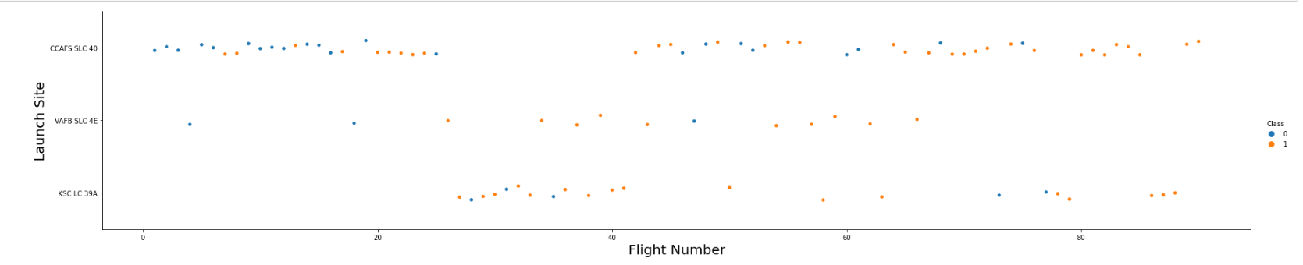
Flight Number vs. Launch Site
Show a scatter plot of Flight Number vs. Launch Site
The more the flights at the launch site the higher the Success Rate at that launch site

Slide 28
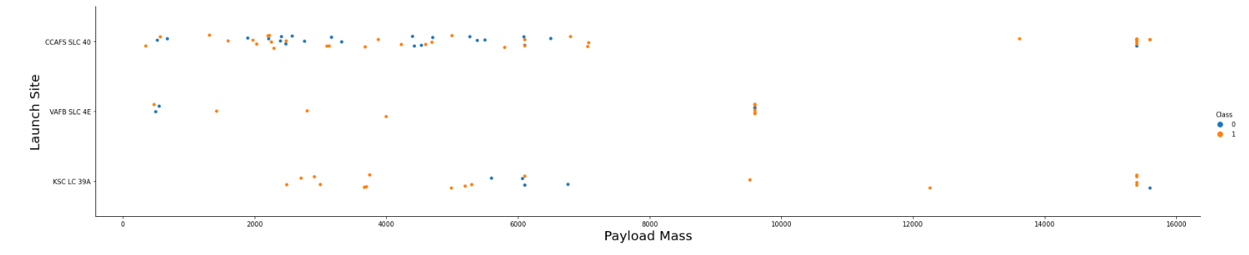
Payload vs. Launch Site
Show a scatter plot of Payload vs. Launch Site
The greater the payload mass, the higher the success rate for the Rocket

Slide 29
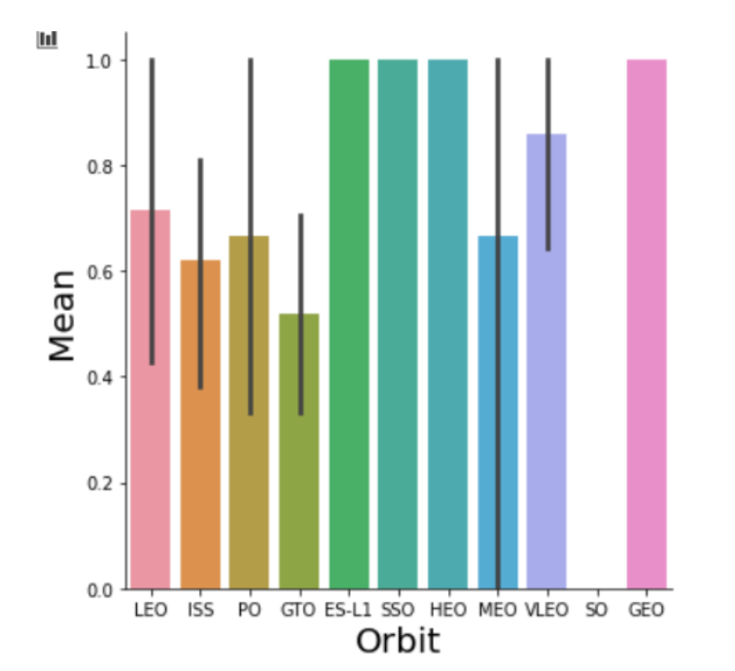
Success Rate vs. Orbit Type
Show a bar chart for the success rate of each orbit type
Orbit ES-L1, GEO, HEO, SSO has the greatest success rate

Slide 30
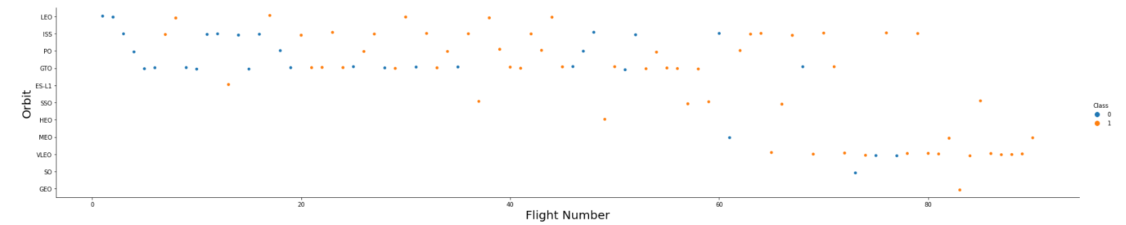
Flight Number vs. Orbit Type
Show a scatter point of Flight number vs. Orbit type
In GTO orbit, the number of flights is directly proportional to the success rate

Slide 31
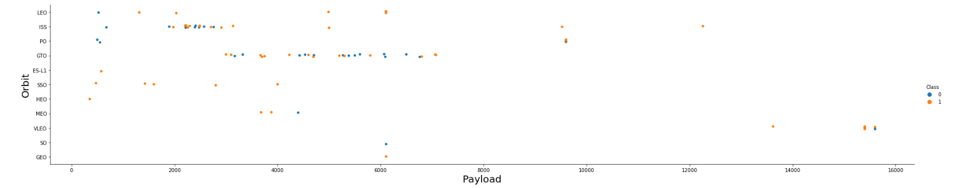
Payload vs. Orbit Type
Show a scatter point of payload vs. orbit type
Heavy loads have negative impact on GTO orbit

Slide 32
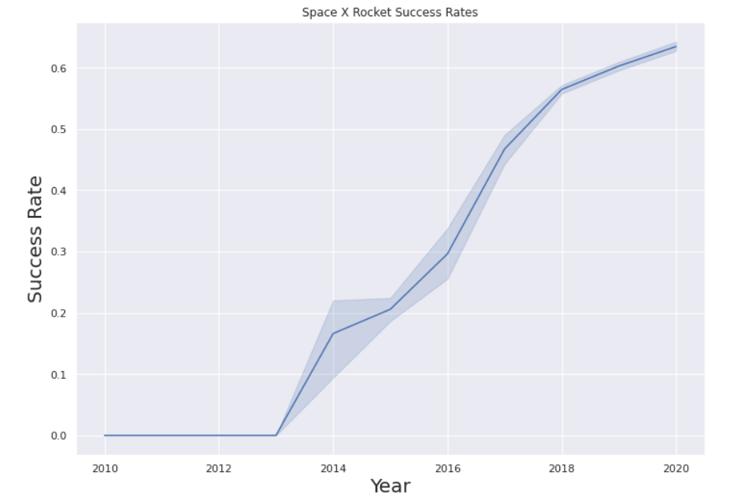
Launch Success Yearly Trend
Show a line chart of yearly average success rate
Since 2013 the success rate has gone upwards

Slide 33
All Launch Site Names
Find the names of the unique launch sites
SQL Query
SELECT distinct launch_site FROM SPACEXTBL
The keyword ‘distinct’ selects only unique values from the launch site column of the table SPACEXTBL
launch_site
CCAFS LC-40
CCAFS SLC-40
KSC LC-39A
VAFB SLC-4E

Slide 34
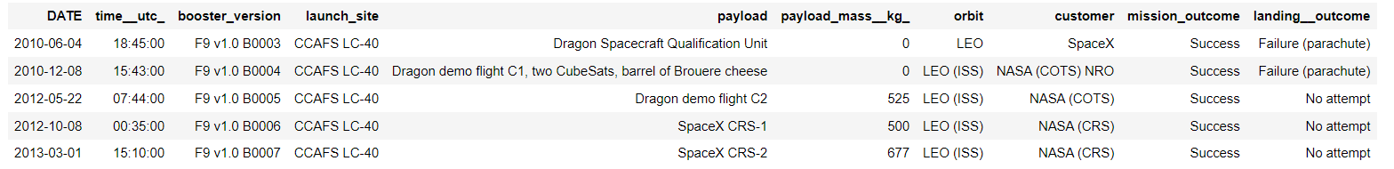
Launch Site Names Begin with 'CCA'
Find 5 records where launch sites begin with `CCA`
SQL Query
SELECT * FROM SPACEXTBL WHERE launch_site like 'CCA%'
LIMIT 5
The top five records are picked from the SPACEXTBL using pattern matching feature using ‘like’ keyword. Records are picked where launch site begins with ‘CCA’.

Slide 35
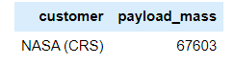
Total Payload Mass
Calculate the total payload carried by boosters from NASA
SELECT CUSTOMER, SUM(payload_mass__kg_) as PAYLOAD_MASS
FROM SPACEXTBL
GROUP BY CUSTOMER
HAVING CUSTOMER = 'NASA (CRS)’
Using the function SUM, the payload_mass__kg_ is added for all the selected records where customer is ‘NASA (CRS).

Slide 36
Average Payload Mass by F9 v1.1
Calculate the average payload mass carried by booster version F9 v1.1
SELECT AVG(payload_mass__kg_) from SPACEXTBL where booster_version = 'F9 v1.1’
Average Payload Mass
3209
Using the AVG function, we calculate the average of payload_mass__kg for booster_version ‘F9 v1.1’ from the SPACEXTBL

Slide 37
First Successful Ground Landing Date
Find the dates of the first successful landing outcome on ground pad
SELECT MIN(DATE) from SPACEXTBL where mission_outcome = 'Success’
DATE
2010-04-06
Using the MIN function on the ‘Date’ column, the minimum date is selected when the mission outcome was a ‘Success’

Slide 38
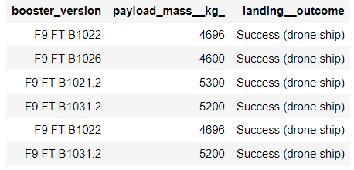
Successful Drone Ship Landing with Payload between 4000 and 6000
List the names of boosters which have successfully landed on drone ship and had payload mass greater than 4000 but less than 6000
select booster_version, payload_mass__kg_, landing__outcome
from SPACEXTBL where landing__outcome = 'Success (drone ship)'
and ( payload_mass__kg_ > 4000 and payload_mass__kg_ < 6000)
We select the ‘booster_version’ column from the table SPACEXTBL where ‘landing__outcome’ column has ‘Success (drone ship) as its value and ‘payload_mass__kg_’ column has value between 4000 and 6000

Slide 39
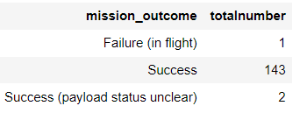
Total Number of Successful and Failure Mission Outcomes
Calculate the total number of successful and failure mission outcomes
select mission_outcome, count(mission_outcome) as TotalNumber from SPACEXTBL
group by mission_outcome
We select the ‘mission_outcome’ column and also count there occurrences in the table SPACEXTBL. We then use the ‘group by’ clause to aggregate their respective counts and present the results as a single row output.

Slide 40
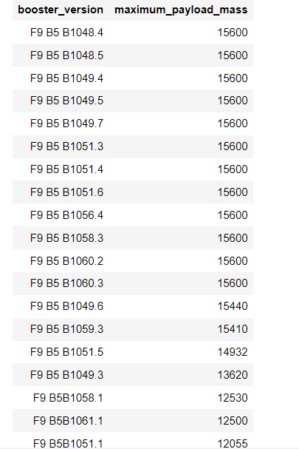
Boosters Carried Maximum Payload
List the names of the booster which have carried the maximum payload mass
SELECT DISTINCT booster_version, max(payload_mass__kg_) AS Maximum_Payload_Mass
FROM SPACEXTBL GROUP BY Booster_Version
ORDER BY Maximum_Payload_Mass DESC
We use the ‘distinct’ clause to select uniqie booster_version, and further only pick the rows where the column ‘payload_mass__kg_’ has the maximum value using the group by clause. We then use the ‘order by’ clause to display the results in descending order.

Slide 41
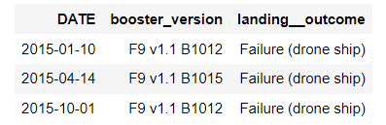
2015 Launch Records
List the failed landing_outcomes in drone ship, their booster versions, and launch site names for in year 2015
select date,booster_version, landing__outcome from SPACEXTBL
where landing__outcome like '%Failure (drone ship)'
and DATE like '2015%’
The columns ‘date’, ‘booster_version’, and ‘landing__outcome’ are selected from the SPACEXTBL where the ‘landing__outcome’ is a ‘Failure (drone ship) and the date is like ‘2015’ i.e. records are selected for the year ‘2015’

Slide 42
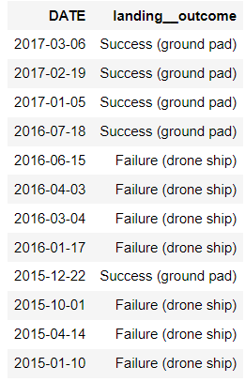
Rank Landing Outcomes Between 2010-06-04 and 2017-03-20
Rank the count of landing outcomes (such as Failure (drone ship) or Success (ground pad)) between the date 2010-06-04 and 2017-03-20, in descending order
select date, landing__outcome from SPACEXTBL
where (landing__outcome = 'Failure (drone ship)’
or landing__outcome = 'Success (ground pad)’)
and (date >= '2010-06-04’
and date <= '2017-03-20’) order by date desc
We select the columns ‘date’ and ‘landing__outcome’ from the SPACEXTBL where ‘landing__outcome’ is either ‘Failure (drone ship)’ or ‘Success (ground pad)’ and ‘date’ is between ‘2010-04’ and ‘2017-03-20’ and the results are ordered by date in descending order

Slide 43


Slide 44

Folium Map Showing the launch sites on the coasts
Explore the generated folium map and make a proper screenshot to include all launch sites’ location markers on a global map
We can see that all the launch sites in the US are located on the near the se coasts and are in Florida and California regions.

Slide 45
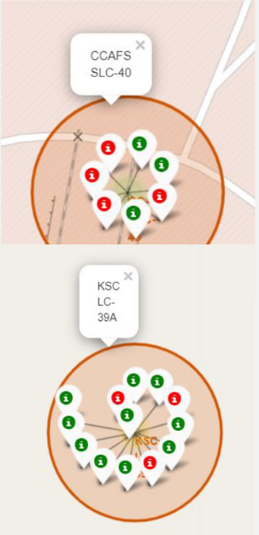
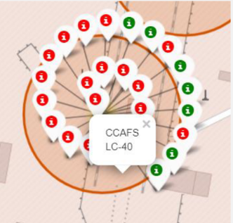
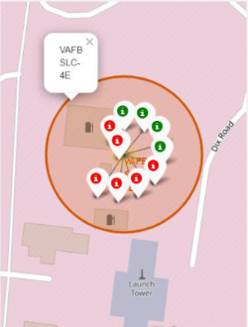
<Folium Map Screenshot 2>
Replace <Folium map screenshot 2> title with an appropriate title
Explore the folium map and make a proper screenshot to show the color-labeled launch outcomes on the map
Green Markers show successful launches and Red Markers show failures.
Florida Launch Site California Launch Site
Explain the important elements and findings on the screenshot

Slide 46


Slide 47
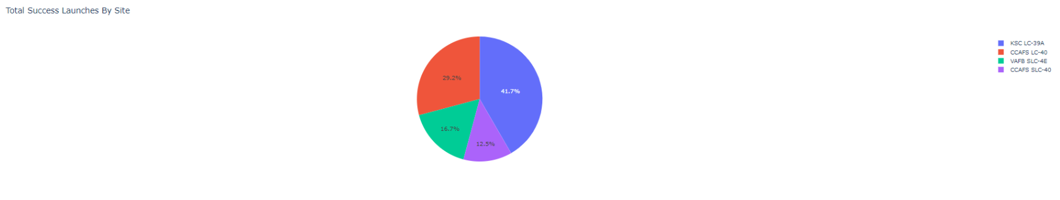
Pie Chart for Launch Success Count for all sites
Pie chart showing the launch success count for all sites.
The success rate for launch site KSC LC-39A is the highest.

Slide 48
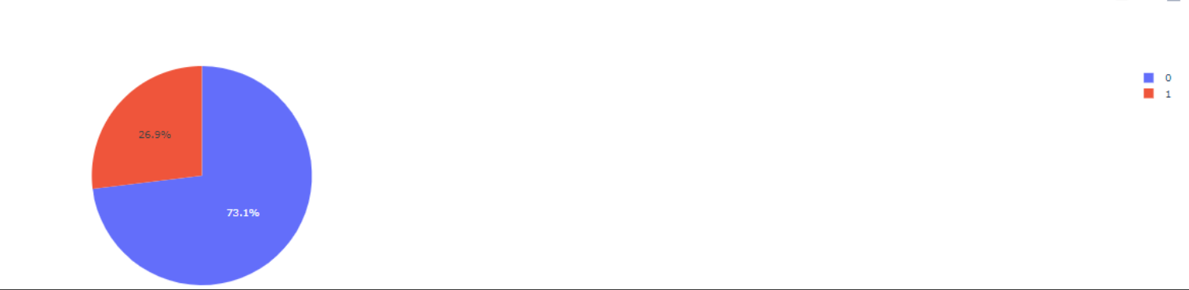
Pie chart for the launch site with highest launch success ratio
Show the screenshot of the piechart for the launch site with highest launch success ratio
KSC LC-39A achieved a success rate of 73.1% and a failure rate of 26.9%.

Slide 49
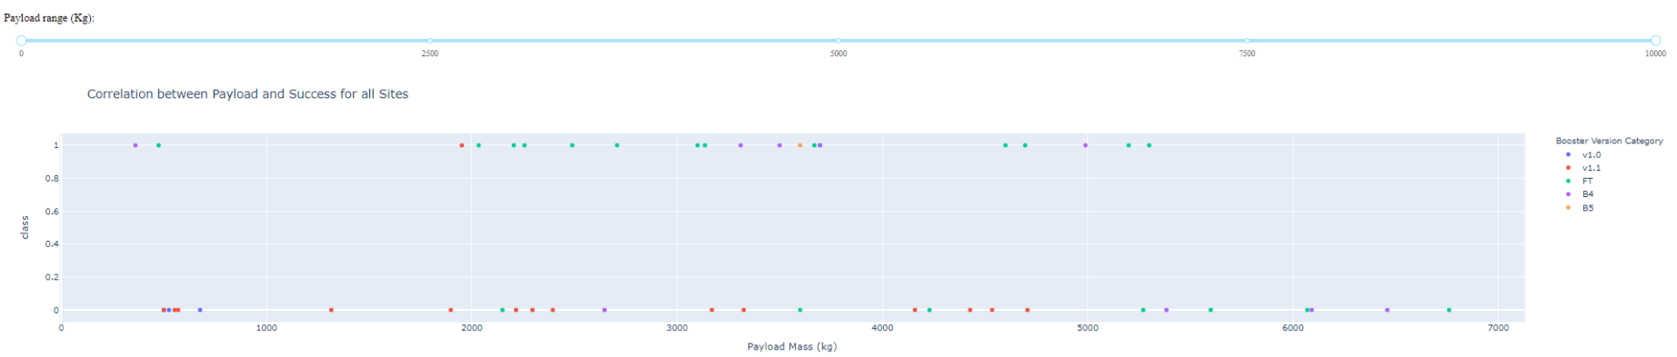
Scatter Plot of Success Rates for all Launch Sites
Show screenshots of Payload vs. Launch Outcome scatter plot for all sites, with different payload selected in the range slider
Success Rate is maximum when the payload is between 3000 and 4000 Kg. When the payload increases above 5000 Kg, the success rate decreases.

Slide 50


Slide 51
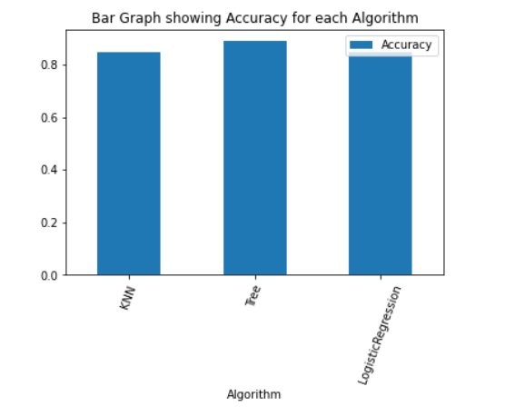
Classification Accuracy
Visualize the built model accuracy for all built classification models, in a bar chart
Tree accuracy : 0.8892857142857145
KNN accuracy : 0.8482142857142858
Logistic Regression accuracy : 0.8464285714285713
The tree algorithm wins

Slide 52
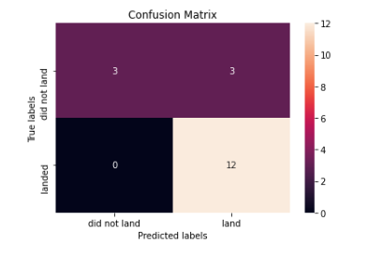
Confusion Matrix
Examining the confusion matrix, we see that Tree can distinguish between different classes. We see that major problem is false positives.

Slide 53
Conclusions
The Tree Classifier Algorithm is the best for the Machine Learning for this specific dataset
Lighter payloads perform bettwe than the heavier payloads
Orbit GEO, HEO, SSO,ED-L1 have the best success rates for the launches.
…

Slide 54
Appendix
Used Python, Matplotlib, Folium, Dash
Created SQL queries
Uploaded the notebooks to github
capstone-project/SpaceX_Machine Learning Prediction_Part.ipynb at main · cheemh/capstone-project (github.com)
https://github.com/cheemh/capstone-project/blob/main/jupyter-labs-eda-dataviz.ipynb
https://github.com/cheemh/capstone-project/blob/main/jupyter-labs-eda-sql-coursera.ipynb
https://github.com/cheemh/capstone-project/blob/main/labs-jupyter-spacex-Data%20wrangling.ipynb
https://github.com/cheemh/capstone-project/blob/main/jupyter-labs-spacex-data-collection-api-Final.ipynb

Slide 55


